Slide 1
DATA STRUCTURES & algorithms

Slide 2
Arrays as data structures
An array is the most commonly used data storage structure;
We will examine how the insertion, search, and deletion algorithms work in arrays

Slide 3
Review Creating arrays – procedural approach
#include <iostream>
using namespace std;
int main()
{
int arr[100]; //array
arr[0] = 77; //insert 10 items
arr[1] = 99;
arr[2] = 44;
arr[3] = 55;
arr[4] = 22;
arr[5] = 88;
arr[6] = 11;
arr[7] = 00;
arr[8] = 66;
arr[9] = 33;
for(int j=0; j<10; j++) //display items
cout << arr[j] << “ “;
return 0;
}
Exercise: Modify the insert method to accept data from the user instead

Slide 4
Review Creating arrays – OOP approach
#include <iostream>
using namespace std;
class myArray
{
private:
int v[100]; //array doubles
public:
void insert()
{ v[0]= 77; //insert 10 items
v[1]= 99;
v[2]= 44;
v[3]= 55;
v[4]= 22;
v[5]= 88;
v[6]= 11;
v[7]= 00;
v[8]= 66;
v[9]= 33;
} //array, at index
void display()
{for(int j=0; j<10; j++) //display items
cout << v[j] << " ";
cout << endl;
}
};
int main()
{
myArray arr; //create an object
arr.insert();
arr.display();
return 0;
}
Exercise: Modify the insert method to accept data from the user instead

Slide 5
Insert and display algorithms
The previous example makes use of two algorithms:
Insert – adds an element at the last available space
Display – shows all the elements in the array.
These are the simplest array algorithms and are often introduced when learning arrays.
Search and Delete are slightly more complex. We look at them next

Slide 6
Search algorithms
Searching calls for receiving an element value to search for (search key).
The search key is compared to each element in the array
Finally a message displayed if it was found or not
bool find(int searchKey) //receive search key
{
for(int j=0; j<10; j++) //compare each element,
if(v[j] == searchKey) //if found
break; //exit loop before end
if(j == 10) //if end without find
return false; // return can’t find it expression
else
return true; //return found it expression
} //end find()
};
Illustration
Notes:
2D Array→
int search(){
cout<<"Enter the student ID Number to search for"<<endl;
cin>>ans;
for (rows=0; rows<nrows; rows++){
for (cols=0; cols<nrows; cols++){
if (students[rows][cols]==ans){
cout<<"Student record exits"<<endl;
return 0;
}
}
}
cout<<"Student does not exits"<<endl;
return 0;
}

Slide 7
Complete program
#include <iostream>
using namespace std;
class myArray
{
private:
int v[100]; //array doubles
public:
void insert()
{
v[0]= 77; //insert 10 items
v[1]= 99;
v[2]= 44;
v[3]= 55;
v[4]= 22;
v[5]= 88;
v[6]= 11;
v[7]= 00;
v[8]= 66;
v[9]= 33;
} //array, at index
void display()
{for(int j=0; j<10; j++) //display items
cout << v[j] << " ";
cout << endl;
}
bool find(int searchKey)
{
int j;
for(j=0; j<10; j++) //for each element,
if(v[j] == searchKey) //found item?
break; //exit loop before end
if(j==10) //ended without find
return false; // can’t find it
else
return true; //found it
} //end find()
};
int main()
{
myArray arr; //create an object
arr.insert();
arr.display();
if( arr.find(35) )
cout << "Found " << endl;
else
cout << "Cant find " << endl;
return 0;
}
Exercise:
Modify the program to ask the user for the search key
What if there were two or more elements equal to the search key?
Can you add a delete function?

Slide 8
Delete algorithm
The delete algorithm is similar to the search because it has to search for the item to delete first.
When it finds that element, it shifts all the elements in higher index cells down one cell, thus overwriting the deleted value
You can call display() member function again after deleting to confirm
bool remove(int deleteKey)
{
int j;
for(j=0; j<10; j++) //look for it
if( deleteKey == v[j] )
break;
if(j==10) //can’t find it
return false;
else //found it
{
for(int k=j; k<10; k++) //move higher ones down
v[k] = v[k+1];
return true;
}
} //end delete()
Exercise: Add the delete function to your program.
Notes:
2D Delete →
int mydelete(){
cout<<"Enter the ID number to delete the record"<<endl;
cin>>ans2;
for (rows=0; rows<nrows; rows++){
for (cols=0; cols<2; cols++){
if (students[rows][cols]==ans2){
for(int k=rows; k<nrows; k++) //move higher ones down
{
students[k][cols] = students[k+1][cols];
students[k][cols-1] = students[k+1][cols-1];
}
nrows=nrows-1;
return 0;
}
}
}
cout<<"ID number does not exits"<<endl;
return 0;
}

Slide 9
Complete program
#include <iostream>
using namespace std;
class myArray
{
private:
int v[100]; //array doubles
public:
void insert()
{
v[0]= 77; //insert 10 items
v[1]= 99;
v[2]= 44;
v[3]= 55;
v[4]= 22;
v[5]= 88;
v[6]= 11;
v[7]= 00;
v[8]= 66;
v[9]= 33;
} //array, at index
void display()
{for(int j=0; j<10; j++) //display items
cout << v[j] << " ";
cout << endl;
}
bool find(int searchKey)
{
int j;
for(j=0; j<10; j++)
if(v[j] == searchKey)
break;
if(j==10)
return false;
else
return true;
} //end find()
bool remove(int deleteKey)
{
int j;
for(j=0; j<10; j++) //look for it
if( deleteKey == v[j] )
break;
if(j==10) //can’t find it
return false;
else //found it
{
for(int k=j; k<10; k++) //move higher ones down
v[k] = v[k+1];
return true;
}
} //end delete()
};
int main()
{
myArray arr; //create an object
arr.insert();
arr.display();
if( arr.find(35) )
cout << "Found " << endl;
else
cout << "Cant find " << endl;
if( arr.remove(55))
cout << "Deleted " << endl;
else
cout << "Cant find " << endl;
arr.display();
return 0;
}
Exercise: Modify the program to ask the user for a number to delete

Slide 10
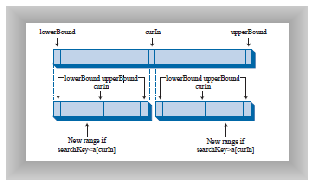
Ordered Arrays
The ordered array is a special array in which the data is stored in ascending (or descending) key order.
Ordered arrays increase the speed of searching for data.
Linear search - With unordered arrays the only way to search for data is to go through each element. This is called a linear search. At best the first element is what you are searching for. At worst case it at the end thus search time=full array
Binary Search - With ordered arrays you can pick the midpoint of the array and if the figure you are looking for is higher or lower you only need to move to one side and pick the midpoint again. Notice this way you don’t need to go through the entire array. You can get lucky and find the search key at the first midpoint. Thus search time=zero. Or at worst you only need to go through half the array. Thus search time=half array.

Slide 11
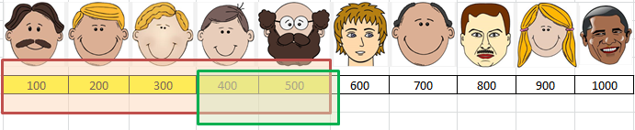
Binary search algorithm

Slide 12
Binary search algorithm
Create three variables to mark the minimum, mid, and maximum array indexes . The mid can be calculated by (min+max)/2
Check if mid is the search key. If it is display found.
If it is not check if search key is above or below and go to the correct half.
Treat the new half as a new full array and repeat the process i.e. redefine the new min (if search key is above-min=mid+1) or max (if search key is below-max=mid-1).
You will know the search key wasn’t found if mid becomes greater than max➔ overlaps
int find(int searchKey)
{
int lowerBound = 0;
int upperBound = 9;
int mid;
while(true)
{
mid = (lowerBound + upperBound ) / 2;
if(v[mid]==searchKey)
return mid; //found it
else if(lowerBound > upperBound)
return 0; //can’t find it
else //divide range
{
if(v[mid] < searchKey)
lowerBound = mid + 1; //it’s in upper half
else
upperBound = mid - 1; //it’s in lower half
} //end else divide range
} //end while
} //end find()

Slide 13
The Complete program
int find(int searchKey)
{
int lowerBound = 0;
int upperBound = 9;
int mid;
while(true)
{
mid = (lowerBound + upperBound ) / 2;
if(v[mid]==searchKey)
return mid; //found it
else if(lowerBound > upperBound)
return 0; //can’t find it
else //divide range
{
if(v[mid] < searchKey)
lowerBound = mid+ 1; //it’s in upper half
else
upperBound = mid - 1; //it’s in lower half
} }}};//end else , while, find, class
int main()
{
myArray arr; //create an object
arr.insert();
arr.display();
if( arr.find(55) != 10 )
cout << "Found " << endl;
else
cout << "Cant find " << endl;
return 0;
}
#include <iostream>
using namespace std;
class myArray
{
private:
int v[100]; //array doubles
public:
void insert()
{
v[0]= 11; //insert 10 items
v[1]= 22;
v[2]= 33;
v[3]= 44;
v[4]= 55;
v[5]= 66;
v[6]= 77;
v[7]= 88;
v[8]= 99;
v[9]= 110;
} //array, at index
void display()
{for(int j=0; j<10; j++) //display items
cout << v[j] << " ";
cout << endl;
}
Exercise: Modify the program to work with employee names as input

Slide 14
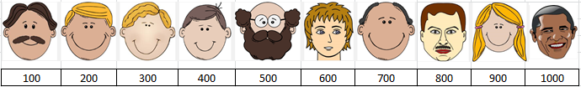
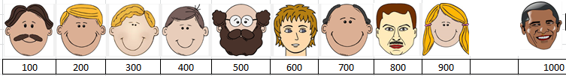
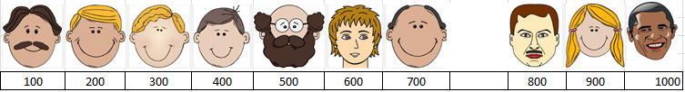
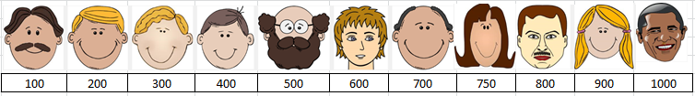
Insert algorithm for ordered arrays
To insert employee number 750 first perform a linier search to find out where 750 should go
Create room by shifting the other elements from the end one element at a time
Insert the employee

Slide 15
The Complete program
int main()
{
myArray arr; //create an object
arr.insert(77); //insert 10 items
arr.insert(99);
arr.insert(44);
arr.insert(55);
arr.insert(22);
arr.insert(88);
arr.insert(11);
arr.insert(00);
arr.insert(66);
arr.insert(33);
arr.display();
return 0;
}
class myArray
{
private:
int v[100]; //array doubles
public:
void insert(int value) //receive element
{
int j;
for(j=0; j<10; j++) //find where it goes
if(v[j] > value) //(linear search)
break;
for(int k=10; k>j; k--) //move elements up
v[k] = v[k-1];
v[j] = value; //insert it
} //end insert()
void display()
{for(int j=0; j<10; j++) //display items
cout << v[j] << " ";
cout << endl;
}
};
Exercise: Modify the program to accept input from the user. Use a loop
Add a delete method for ordered arrays.
Notes:
#include <iostream>
using namespace std;
int s=5;
class student
{
private:
int number[5];
public:
void uinsert()
{
for(int i=0;i<s;i++)
{ cout<<"Enter a number";
cin>>number[i];
}
}
void oinsert()
{
int y;
for(int a=0;a<5;a++)
{
cout<<"Enter a number";
cin>>y;
int i;
for(i=0;i<s;i++)
if(number[i]>y)
{
break;}
for(int j=s;j>i;j--)
number[j]=number[j-1];
number[i]=y;
}
}
void display()
{
for(int i=0;i<s;i++)
{
cout<<"Number:"<<number[i]<<endl;
}
}
int search()
{
int x;
cout<<"Enter a number to search for";
cin>>x;
for(int i=0;i<s;i++)
{
if(x==number[i])
{
cout<<"Found";
return 0;
}
}
cout<<"Not Found";
return 0;
}
int bsearch()
{
int k;
cout<<"Enter a number to search for";
cin>>k;
int lowerBound = 0;
int upperBound = 4;
int mid;
while(true)
{
mid = (lowerBound + upperBound ) / 2;
if (number[mid]==k)
{cout<<"Found";
return 0;
}
else if(lowerBound > upperBound)
{
cout<<"Not found";
return 0; //can’t find it
}
else //if not found
{
if(number[mid] < k)
lowerBound = mid + 1; //it’s in upper half
else
upperBound = mid - 1; //it’s in lower half
} //end else divide range
}
}
//----------------------------------------------------------------------
int mydelete()
{
int x;
cout<<"Enter a number to delete";
cin>>x;
for(int i=0;i<5;i++)
{
if(x==number[i])
{
cout<<"Found";
s=s-1;
for(int j=i;j<5;j++ )
{number[j]=number[j+1];
}
return 0;
}
}
cout<<"Not Found";
return 0;
}
};
int main() {
student s1;
s1.oinsert();
s1.display();
//s1.bsearch();
//s1.mydelete();
//s1.display();
return 0;
}

Slide 16
Delete algorithm for ordered array
Deleting an element in an ordered array calls for:
Performing a binary search to find it
Pushing every element after it forward to overwrite it.
bool remove(int value)
{
int j = find(value); //recall find returns index
if(j==10) //can’t find it
return false;
else //found it
{
for(int k=j; k<10; k++) //move bigger ones down
v[k] = v[k+1];
return true;
}
} //end remove()
Exercise: Write the complete program

Slide 17
The Advantages of Using Ordered Arrays
Advantages:
Searching is fast
Disadvantages:
Insertion is slow as we have to find the correct position
Deleting is slow as everything after deleted item has to be moved one place forward
Thus an ordered array is best for scenarios where searches are more common than insertions and deletions. E.g. an employee database. Often data is searched to update a record rather than hire or fire an employee (insert or delete) a record. An inventory for a retail store is however not a good database to use an ordered array as items are added and deleted all the time.

Slide 18
Evaluating Data structures
How many steps are necessary to perform a binary search on a given array? Assume an array of size 10. Lets pick an index to search :
say 3. We check index 5, then 3, and find it...2 mid pt checks
say 4. We check index 5, then 3, then 4 and find it...3 mid pt checks
say 1. We check index 5, then 3, then 2, then 1, and find it...4 mid pt checks
With a binary search the first and last element take the most checks. For an array of size 10 any index position can be found with less than 4 checks.
Thus for an array of size 100, index calls for checking a maximum of 50, 25, 12, 6, 3, 2, and 1...7 checks…
For an un ordered array the best case would be if the item is the first in the array and the worst case would be if the item is the last one. We can assume the average of the best and worst case to be the average search time in a linear search. Thus an array of size 10 would take 10/2=5 and array of size 100 would be 100/2=50….or simply N/2

Slide 19
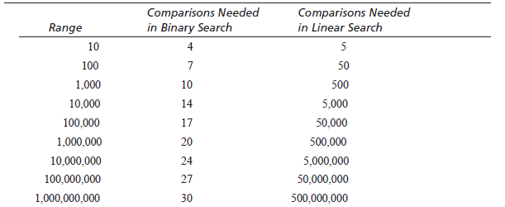
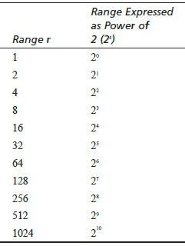
We can summarize this as follows:
Note that for small data the difference is not so significant but as the data increases the speed of a binary search becomes apparent.
Note also that raising two to the comparisons (s) needed gives you a value close to the array size (r). R=2^{s} .

Slide 20
If we want to know the number of checks given the array size we must make s the subject of the formula. Thus:
R=2^{s ➔} s = log₂(r) The inverse of raising something to a power is a logarithm
For example log₂(100) = 6.644 which rounds off to 7.

Slide 21
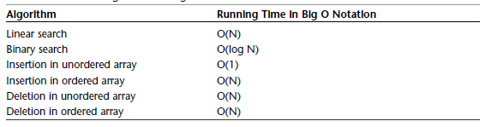
Big o notation
When comparing algorithms, you don’t really care about the particular microprocessor chip or compiler; all you want to compare is how T changes for different array sizes (N).
The Big O notation thus ignores the constant and describes time (T) as the “order of” variations of the size (N) denoted by O()
Thus In Big O notation, we would say that a linear search takes O(N) time (we ignore /2), and a binary search takes O(log N) time. Insertion into an unordered array takes O(1), or constant time.
We find that Insertion into an unordered array takes the least time, followed by a binary search and then a linear search takes the most time.

Slide 22
In an unordered array you can insert items quickly, in O(1) time, but searching is slow O(N) time.
In an ordered array you can search quickly, in O(log N) time, but insertion takes O(N) time.
For both kinds of arrays, deletion takes O(N) time because half the items (on the average) must be moved to fill in the hole.
It would be nice if there were data structures that could do everything—insertion, deletion, and searching—quickly, ideally in O(1) time, but if not that fast, then in O(log N) time.

